Slide 1





SEO AUDIT
COMPREHENSIVE SEO AUDIT & OPTIMIZATION FOR ORGANIC TRAFFIC GROWTH

Slide 2


ABOUT THE COMPANY
Tech Mahindra is a leading global IT and business services provider headquartered in India. It offers a broad range of services, including IT consulting, software development, and business process outsourcing (BPO)
INDUSTRIES SERVED
TECHNOLOGIES USED
Telecommunications
Healthcare
Financial Services
Manufacturing
Artificial Intelligence (AI)
Cloud Computing
Blockchain
Internet of Things (IoT)

Slide 3
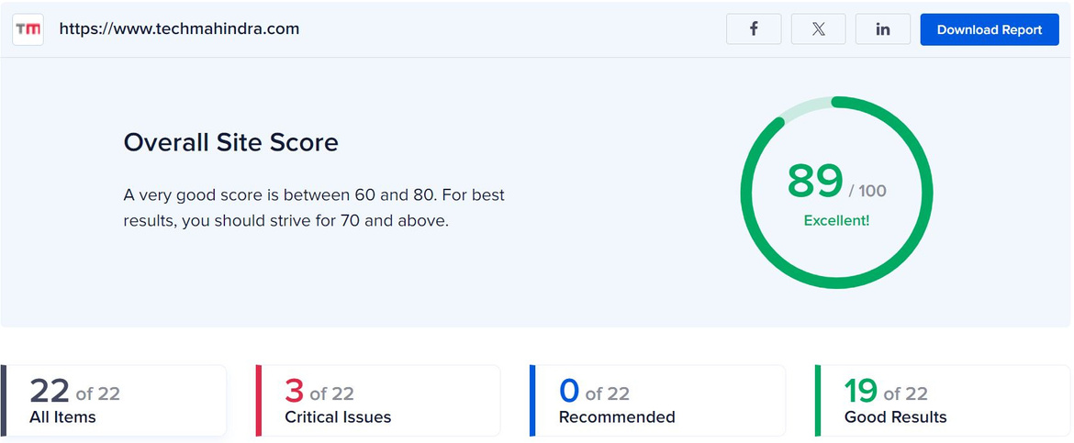
1 - INITIAL AUDIT
CURRENT PERFORMANCE
The website appears to have a strong online presence and is well-indexed by search engines
Initial review suggests good keyword targeting but potential room for optimization in long-tail keywords and content relevancy
STRENGTHS
WEAKNESS
Professional and modern website design with a clean, intuitive layout
User-friendly navigation and responsive design for mobile devices
Secure HTTPS connection
Comprehensive coverage of services and solutions offered
High-quality visuals and case studies that enhance credibility
Some pages may benefit from more targeted keyword integration and optimization.
Opportunities to enhance content with more long-tail keywords and industry-specific terms
Potential for improvement in meta descriptions and title tags to better reflect page content and improve click-through rates
Page speed and load times could be further optimized.
Potential issues with structured data implementation and mobile performance (requires deeper analysis)

Slide 4
2 - KEYWORD RESEARCH
TARGETED KEYWORDS
1
2
3
PRIMARY KEYWORDS
SECONDARY KEYWORDS
LONG-TAIL KEYWORDS
IT consulting services
Business process outsourcing
Digital transformation solutions
Cloud computing services
Artificial intelligence solutions
IT infrastructure management
Managed services
Customer experience management
IT consulting services for telecommunications
Digital transformation solutions for healthcare
How Tech Mahindra’s IT solutions enhance business operations
Business process outsourcing for finance sector

Slide 5
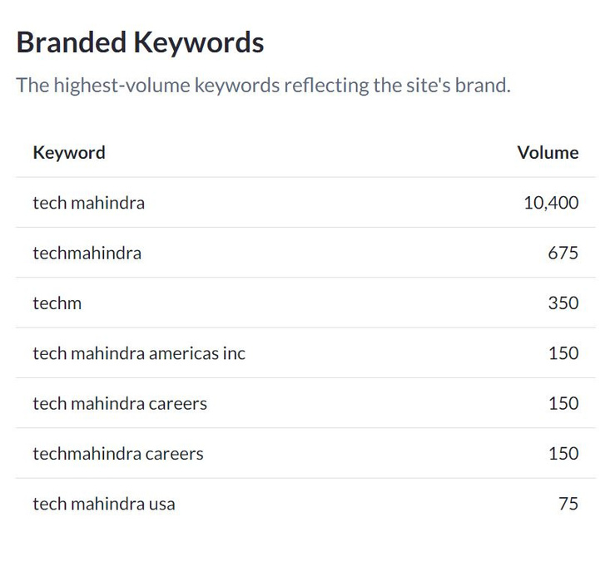
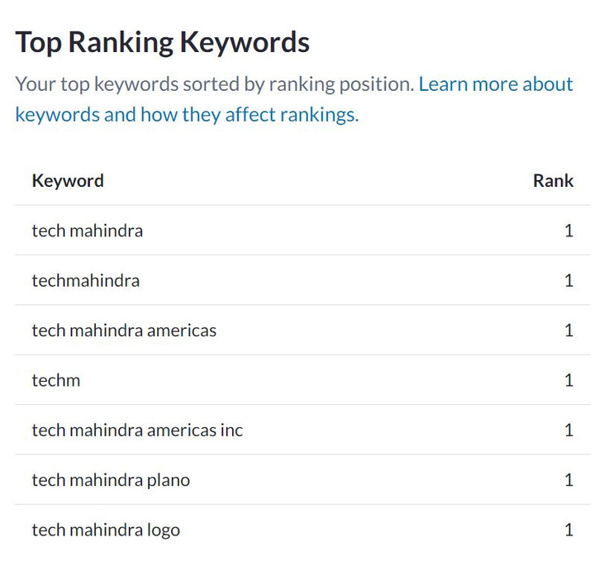
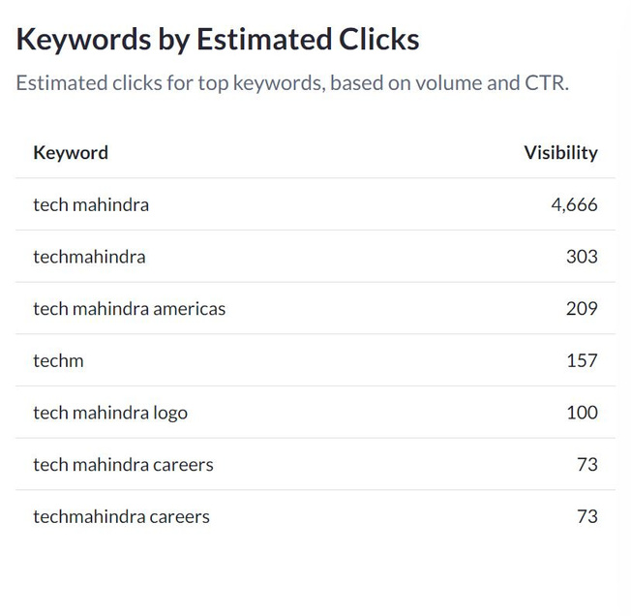
2 - KEYWORD RESEARCH
THE DRIVING KEYWORDS

Slide 6



2 - KEYWORD RESEARCH
COMPETITOR KEYWORDS
Infosys: Digital innovation, IT strategy consulting, cloud migration services.
Wipro: Managed IT services, enterprise software solutions, cybersecurity.
Accenture: Strategy consulting, industry 4.0, IT modernization.
KEYWORD GAPS
Infosys: Keywords like “digital innovation,” “IT strategy consulting” are missing for Tech Mahindra.
Wipro: “Managed IT services,” “enterprise software solutions” are not targeted by Tech Mahindra.
Accenture: Keywords such as “strategy consulting,” “industry 4.0,” “IT modernization” are gaps for Tech Mahindra.
LONG-TAIL KEYWORD GAPS
Infosys: “IT strategy consulting for telecom” (a niche area where Tech Mahindra can improve).
Wipro: “Enterprise software solutions for finance” (specific to verticals Tech Mahindra could target more).
Accenture: “Industry 4.0 solutions for manufacturing” (Tech Mahindra could develop content around this).

Slide 7






3 - ON-PAGE SEO OPTIMIZATION
Homepage
SELECTED PAGE :
STRENGTHS
Design
Professional and modern design with a clear layout
Visuals
High-quality images and infographics enhance user engagement
User Experience
Intuitive navigation and responsive design for mobile devices
WEAKNESSES
Title Tag
Include primary keywords like “IT consulting,” “digital transformation
Meta Description
Include relevant keywords and a call-to-action
Headings
Ensure proper use of H1, H2, and H3 tags

Slide 8
3 - ON-PAGE SEO OPTIMIZATION
OTHER RECOMMENDATIONS
1.Internal Linking
Ensure proper internal linking to related services and case studies to enhance user navigation and SEO.
2.Alt Text for Images
Use descriptive and keyword-rich alt text for all images.
3.URL Structure
Ensure URLs are clean, descriptive, and include relevant keywords (e.g., “/services/digital-transformation”).

Slide 9

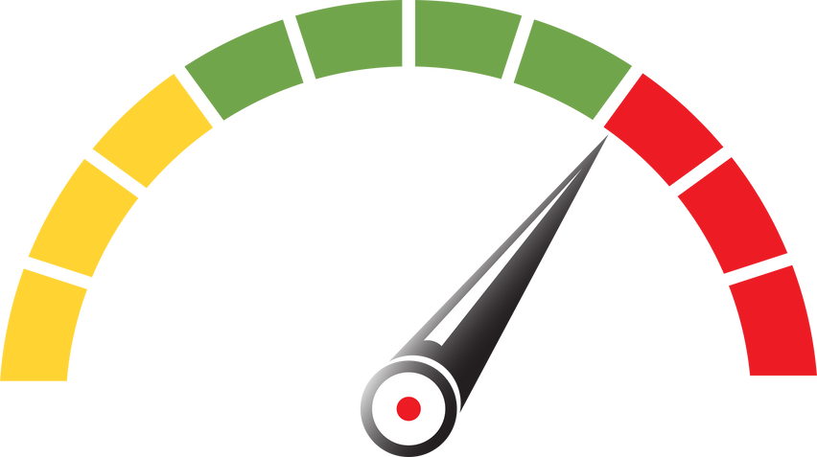

4 - TECHNICAL SEO
Homepage
SELECTED PAGE :
STRENGTHS
Mobile Responsiveness
The site may need improvements in mobile view adjustments
Site Speed
Potential issues include slow loading times due to unoptimized images or non-minified code
Structured Data Implementation
Review required to ensure proper schema markup
5 Best Practices
Optimize images (size & format).
Minify and compress HTML, CSS, and JS.
Leverage browser caching.
Improve server response time.
Use a CDN for faster load times.

Slide 10





5 - CONTENT STRATEGY
Target Audience
Focus content on relevant industry trends and innovations
Blog Topics
Explore themes like digital transformation, emerging technologies, and sustainability in business
Content Types
Develop blogs, case studies, and white papers to showcase expertise and thought leadership
Regular Updates
Ensure content stays current and reflects the latest industry insights
Promotion
Utilize social media and industry publications for content distribution and audience engagement

Slide 11





5 - OFF-PAGE SEO PLAN AND STRATEGY
Link Building
Secure high-quality backlinks from industry-relevant websites
Guest Blogging
Write guest articles for key blogs, linking back to Tech Mahindra
Online Directories
Submit Tech Mahindra to reputable online business directories
Social Media Engagement
Actively engage with potential clients on social media platforms
Online Reviews
Encourage clients to leave positive reviews online to enhance credibility

Slide 12
OUTCOME OF THE PROJECT
Business Understanding: Analyzed Tech Mahindra’s business and domain to align SEO strategies with industry needs
Internal Audit: Highlighted current performance, strengths, and weaknesses to identify priority focus areas
Keyword Research: Identified relevant short-tail and long-tail keywords, ranked keywords, keyword gaps, and competitor strategies; provided recommendations to improve traffic
On-Page SEO Audit: Assessed homepage strengths and weaknesses, developed recommendations for improvement
Technical SEO Audit: Found technical strengths, provided five best practices for enhancement
Content Strategy: Suggested future content ideas to drive traffic
Off-Page SEO: Recommended strategies to strengthen off-page SEO and increase traffic

Slide 13
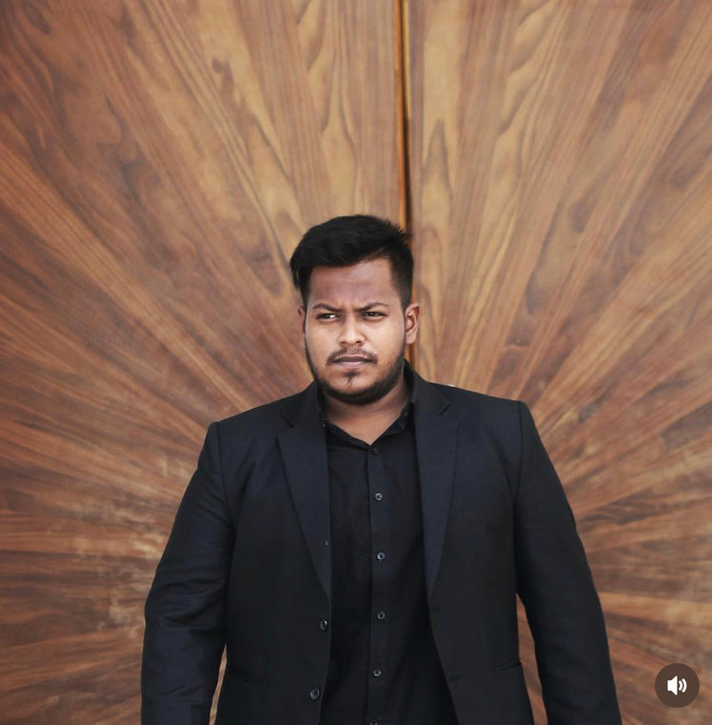
CONCLUSION
This project identified key SEO strengths, weaknesses, and opportunities for Tech Mahindra, providing actionable recommendations to enhance on-page, technical, and off-page SEO, driving more targeted traffic
SUBMITTED BY
MOHAMED AFSAR M I
BADM - MB26
MIAFSAR@GMAIL.COM
+91 96774 76692
THANK YOU

